Slide 1
Email Investigations

Slide 2
Friday class
Lets work on our projects.
I will be in Leahy 103 – please bring questions and issues.

Slide 3
Objectives
Hoe does email work?
Explain the role of e-mail in investigations
Describe client and server roles in e-mail
Describe tasks in investigating e-mail crimes and violations
Describe some specialized e-mail forensics tools

Slide 4
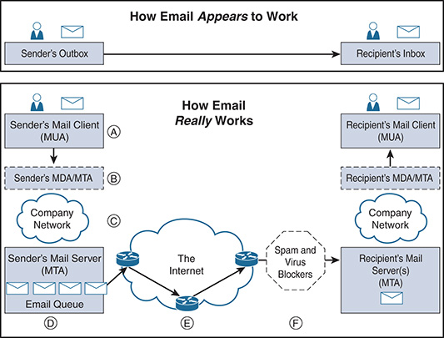
How does email work?

Slide 5
Email investigations
A user composes an email through Mail User Agent(MUA).
Public:
Gmail, Outlook, Yahoo! Mail
Corporate world
Microsoft Outlook, Mac Mail, Mozilla Thunderbird, IBM’s Lotus Notes
The email is sent to a mail transfer agent (MTA) (email server) – MS Exchange.
The MTA routes mail into local mailboxes or forwards to the Internet if no local mailboxes exist.

Slide 6
Email
If a local mailbox does not exist, the MTA → Domain Name System (DNS) to determine where to send the email based on the recipient’s top-level domain (TLD).
The DNS system queries the recipient’s domain to see if a Mail Exchange (MX) record exists
The sender’s MTA asks the DNS system what server within the recipient’s domain will accept the email.
The DNS system replies back and provides the recipient’s domain MX server and IP address/
Simple Mail Transfer Protocol - protocol used by the email server to send mail to other email servers.

Slide 7
Example
My email server is mail.drshumba.com (X)
Wants to send an email to mail.yourserver.com (Y).
X asks the DNS, “How do I send email to yourserver.com domain?”
DNS replies to X with the MX record mail.yourserver.com and the IP address of that server.
MX record –specifies the mail server responsible for accepting email messages on behalf of the domain name.

Slide 8
The Role of E-mail in Investigations
An increase in e-mail scams and fraud attempts with phishing or spoofing
Investigators need to know how to examine and interpret the unique content of e-mail messages
Phishing e-mails contain links to text on a Web page
Attempts to get personal information from reader
Pharming - DNS poisoning takes user to a fake site
A noteworthy e-mail scam was 419, or the Nigerian Scam
Spoofing e-mail can be used to commit fraud

Slide 9
Investigating E-mail Crimes and Violations
Similar to other types of investigations
Goals
Find who is behind the crime
Collect the evidence
Present your findings
Build a case
Know the applicable privacy laws for your jurisdiction
Electronic Communications Privacy Act (ECPA) and the Stored Communications Act (SCA) apply to e-mail.

Slide 10
Investigating email crimes and violations
Electronic Communications Privacy Act (ECPA) and the Stored Communications Act (SCA) apply to e-mail.
What are these acts about?
How would you approach email investigations?

Slide 11
Email investigations
Email servers
View email headers
Trace email – where is the email originating from?

Slide 12
E-mail Servers
E-mail logs generally identify the following:
E-mail messages an account received
Sending IP address
Receiving and reading date and time
E-mail content
System-specific information
Contact suspect’s network e-mail administrator as soon as possible
Servers can recover deleted e-mails
Similar to deletion of files on a hard drive

Slide 13
Using Network E-mail Logs
Router logs
Record all incoming and outgoing traffic
Have rules to allow or disallow traffic
You can resolve the path a transmitted e-mail has taken
Firewall logs
Filter e-mail traffic
Verify whether the e-mail passed through
You can use any text editor or specialized tools

Slide 14
Viewing E-mail Headers
Investigators should learn how to find e-mail headers
GUI clients
Web-based clients
After you open e-mail headers, copy and paste them into a text document
So that you can read them with a text editor
Become familiar with as many e-mail programs as possible
Often more than one e-mail program is installed

Slide 15
Viewing E-mail Headers
Gmail
Click the three dots next to the Reply circular arrow, and click Show original
Copy to clipboard
Yahoo
Click Inbox to view a list of messages
Above the message window, click More and click View Raw Message
Copy and paste headers to a text file

Slide 16
Examining E-mail Headers
Headers contain useful information
The main piece of information you’re looking for is the originating e-mail’s IP address
Date and time the message was sent
Filenames of any attachments
Unique message number (if supplied)

Slide 17
Tracing an E-mail Message
Determining message origin is referred to as “tracing”
Contact the administrator responsible for the sending server
Use a registry site to find point of contact:
www.arin.net
www.internic.com
www.google.com
Verify your findings by checking network e-mail logs against e-mail addresses

Slide 18
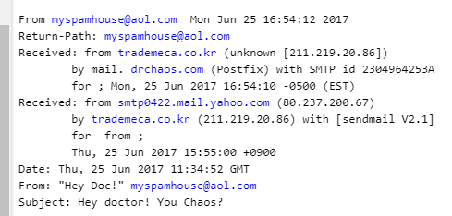
How to examine email headers for spam
Each email client has a different way of displaying the email headers.
Sample email was sent from myspamhouse@aol.com to an email account at Dr.Chaos@drchaos.com.

Slide 19
Questions to ask when examining a header?
Is it likely to be a correct server?
Check the authenticity of the mail server: ping the server
nslookup,
Ping, or
Use iplocation.com to check the location of the server (for both servers)
Check if the servers has the capability of sending email – if it does what port does it need to communicate through? (SMTP port)
May want to connect to that port from your computer. What tool would you use? However what would you see as the problem?

Slide 20
Problem
Our IP maybe logged into the remote server.
The server may be malicious, waiting to send us an attack if we attempt to connect to it?
Honeypot waiting for our connection?
Use website https://mxtoolbox.com/ to check if it can connect to the server:
Use as a proxy – a computer/software that acts as a gateway between an endpoint device.
Is server responding to SMTP requests.

Slide 21
Memorable case
An employee was accused of sending harassing emails to another employee.
I was expecting to find a simple chain from an internal email server.
Multiple received lines in the email header that appeared from web-based email clients.
Turned out the employee was innocent, and the emails were being spoofed externally.

Slide 22
Email investigations
It is likely you will encounter email during an investigation and be asked to validate where it came from.
Practice investigating spam and trusted email to see the difference between how they look via their email headers

Slide 23
Email spoofing
Method one:
One of the easiest ways to spoof emails is to simply use a mass mailer server.
Hundreds of them are available out there, and a quick Google search can reveal how to do that.
Method two:
Find an open SMTP server→telnet from a TOR or VPN client into an SMTP relay by specifying Telnet on port 25, and manually enter SMTP commands such as MAIL FROM:emailaddress@domain as well as RCPT TO:recipient@domain.com → be careful
Researchers and spammers is SimpleEmailSpoofer

